Slide 1
IoT System for pH Monitoring in Industrial Facilities
Pedro Silva nº47128 & Miguel Rocha nº47185 Supervised by: Professor Rui Duarte
Instituto Superior de Engenharia de Lisboa (ISEL)
Engenharia Informática e de computadores (LEIC)

Slide 2
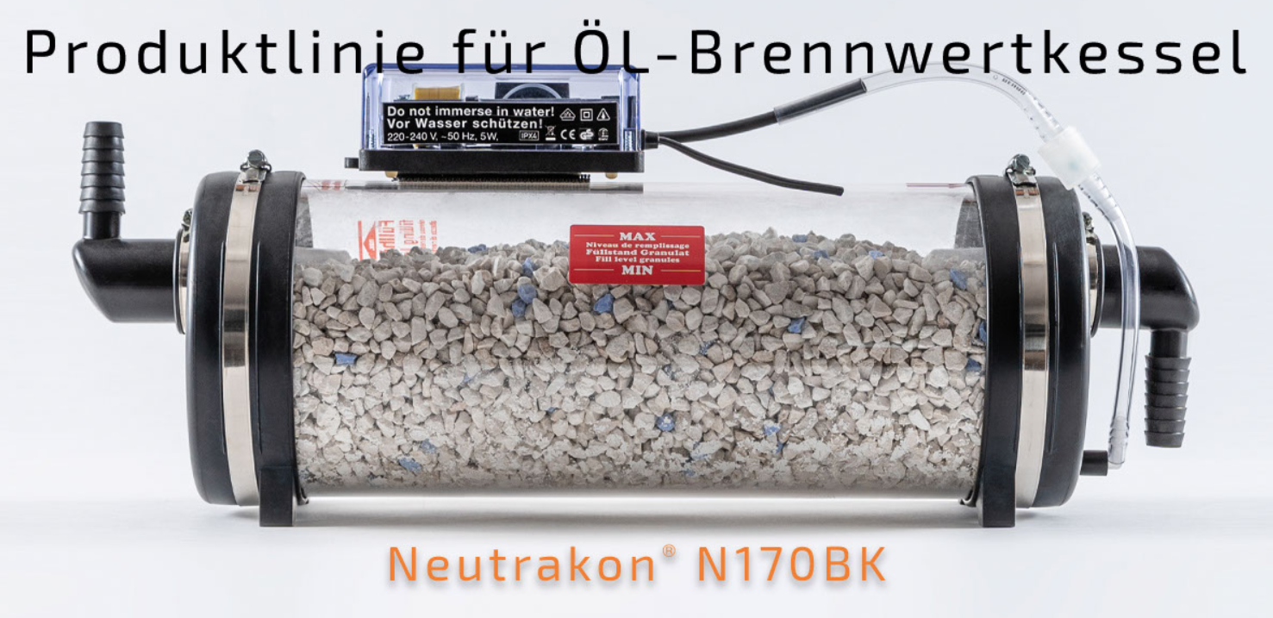
Motivation
3
Solution that leverages the power of the Internet of Things (IoT) to monitor pH levels of water in a neutralisation device, allowing clients to be informed when the device is in need for replacement.
3

Slide 3
Objectives
An electronic system designed to be energy-efficient, equipped with sensors for collecting data, and capable of transmitting the data to the cloud.
A backend responsible for:
Gather the received sensor data;
Process collected data, and alert the user, if necessary;
Expose a Web API, allowing other applications to interact with the system.
Intuitive and secure website, to register devices and consult sensor data.
4

Slide 4
Requirements by the company
Cost-effective integration of the microcontroller unit into IoT Sensor Node;
Prolonged battery life for minimal maintenance requirements;
Comprehensive documentation for user-friendly operation and understanding;
Notification to the filter owner or manager if any value exceeds a safe operation threshold (i.e. proactive maintenance);
4

Slide 5
Additional Requirements
Intuitive and user-friendly website design for easy navigation and access to information;
Proactive sensor calibration;
Adding more sensors to gather more data from the equipment (ex: Temperature sensor, Water sensor, etc)
4

Slide 6
Previous work
SmartDoorLock-IoT
https://github.com/bernardocmarques/SmartDoorLock-IoT
5

Slide 7
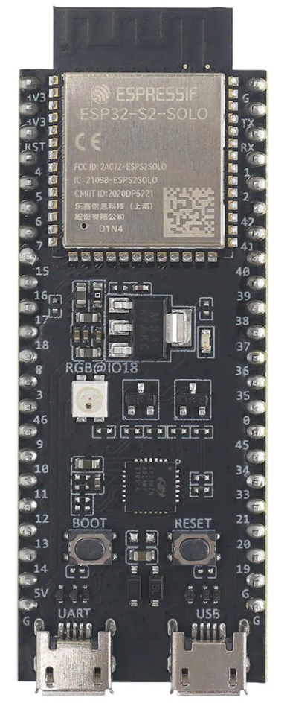

Background – MCU
3
More control over the hardware;
Efficient Wide range of components, libraries, and drivers;
Resource Utilization;
Extensive Documentation.
Sufficient CPU capabilities for our use case;
Built-in Wi-Fi module;
Low power consumption;
Cost-effective.
3

Slide 8
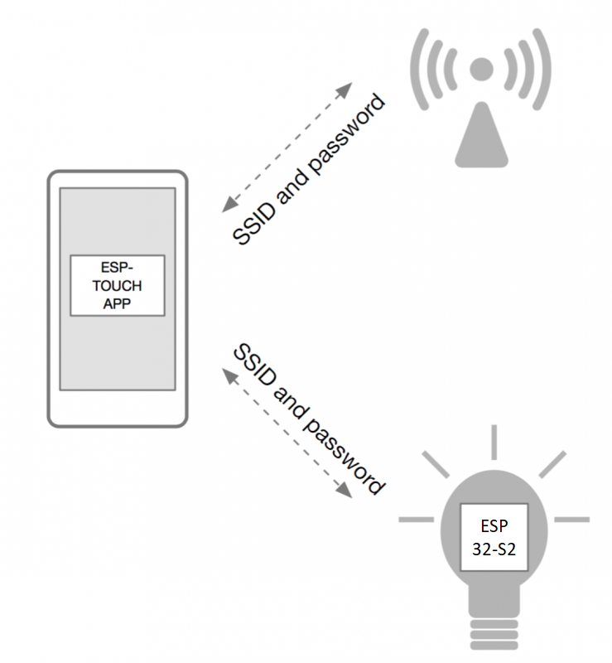
Background – ESP32-S2 Configuration
Easy Setup;
Cross-Platform Compatibility;
Data encryption:
Fast and Reliable;
Open-Source.
11

Slide 9
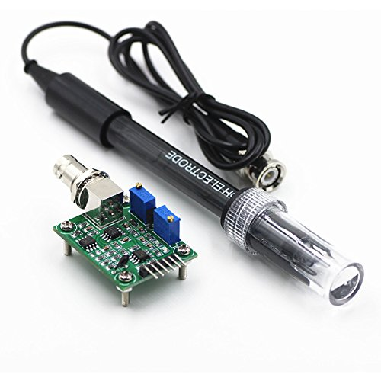
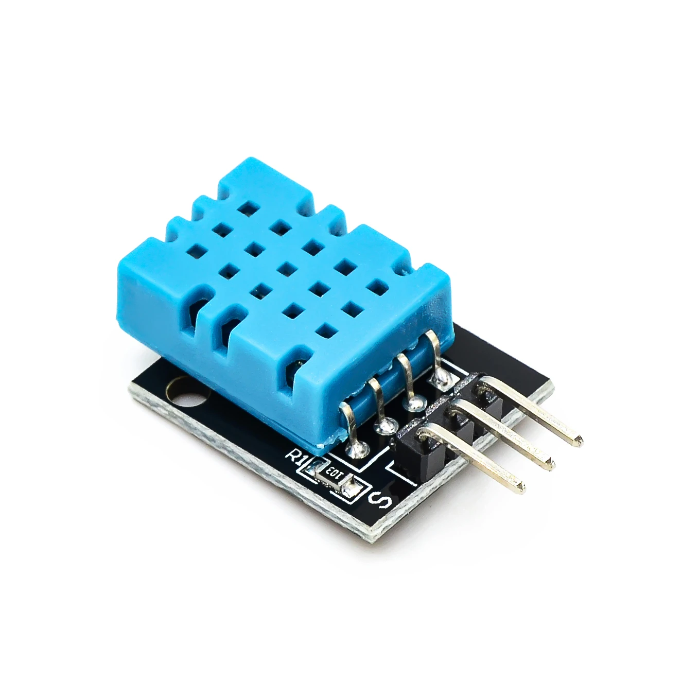
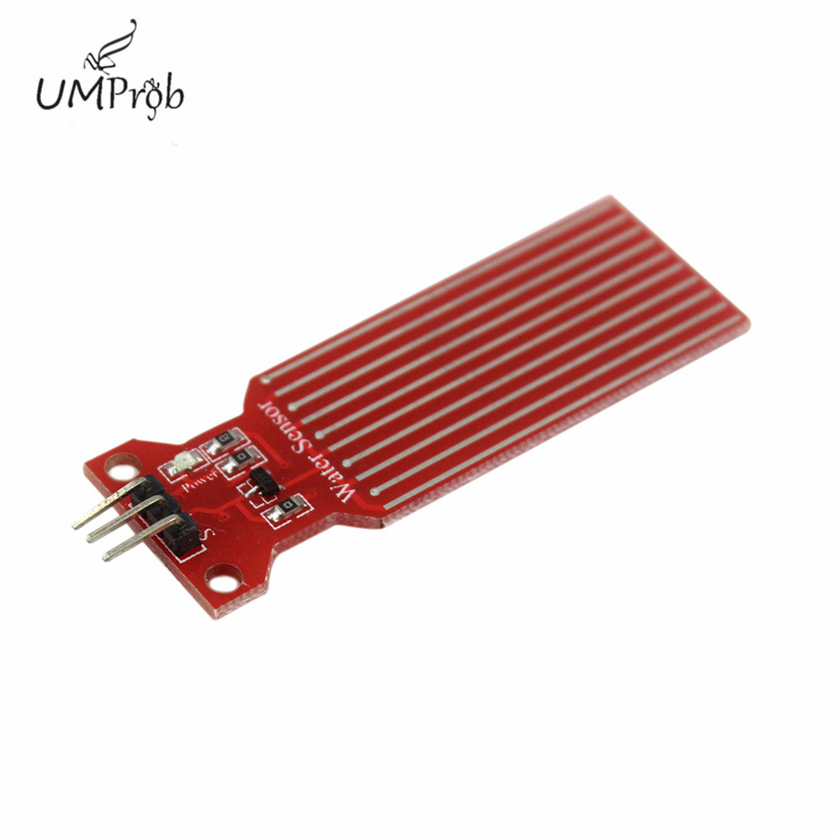
Background – Sensors
3
DHT11
Digital sensor;
Easy to use;
Cost-effective;
Factory calibrated;
Accuracy of ±1 (Cº / %).
Water Sensor
Low-cost;
Wide coverage;
Easy placement.
pH Sensor:
3

Slide 10




Background – Backend
Technologies Used:
Postgres SQL: support for complex queries
InfluxDB: retrieve substantial amounts of data at a high speed.
Kotlin with Spring Boot framework for Backend Server: powerful framework to implement Rest APIs
11

Slide 11
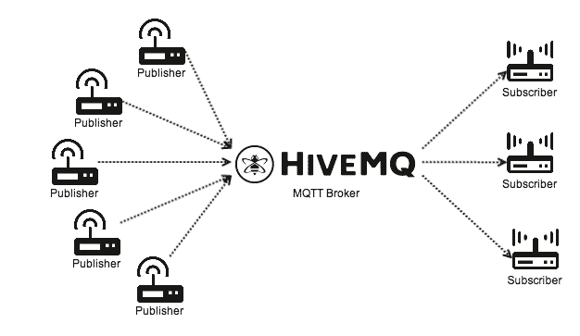
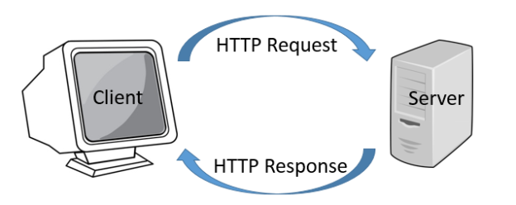
Background – Comunication Protocols
MCU - Backend
Backend - Frontend
11

Slide 12


Background - Frontend
Technologies Used:
React (Frontend): simple and powerful framework for frontend development
React-Bootstrap (Frontend): built in harmonious JavaScript elements
Typescript: type checking
Webpack: Javascript module bundler
14

Slide 13
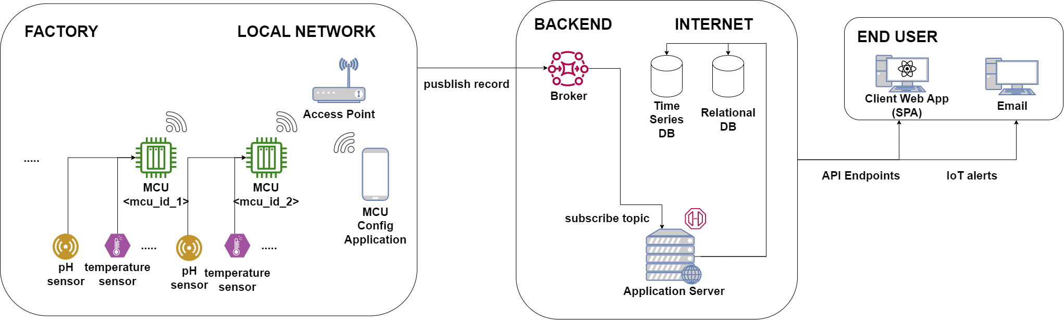
System Overview
3
3

Slide 14
MCU Behaviour
3
Wake up;
Checks Wake Up cause;
Sends wake-up log to backend, if necessary;
Makes sensor readings (all sensors or just water sensor);
Transmits readings to backend;
Goes to sleep for 6 hours;
3

Slide 15
Proactive Sensor Calibration
3
3

Slide 16
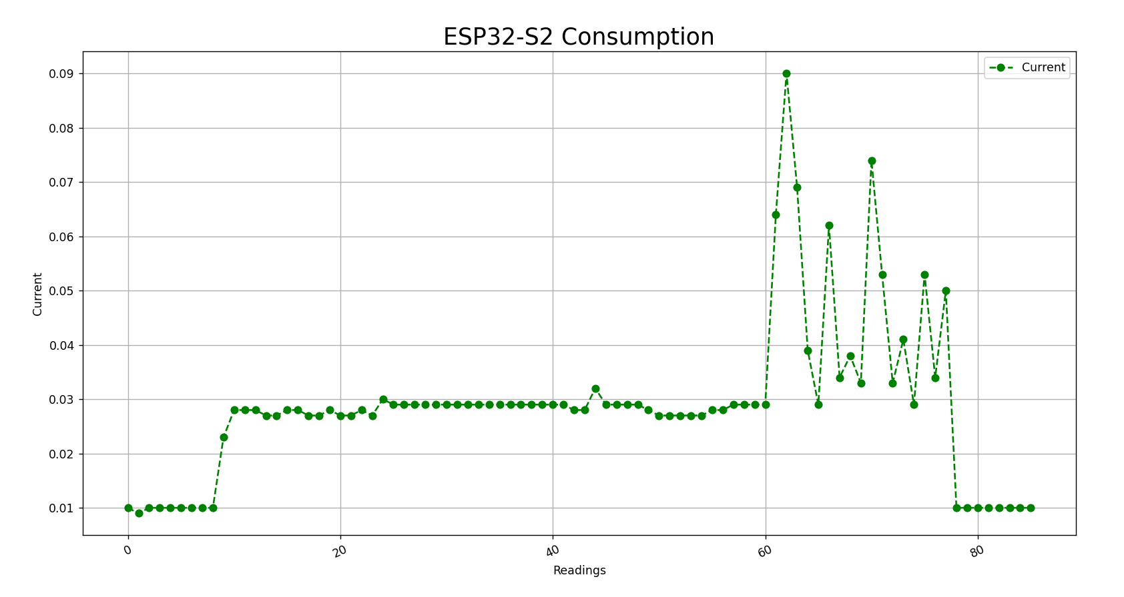
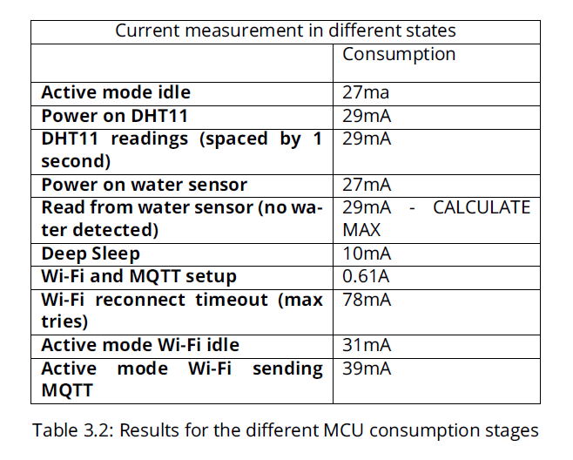
ESP Consumption
3
(EnergyPerCycle + EnergyPer6HourInDeepSleep) ∗ NumberOfWakeUps = 3400
3

Slide 17
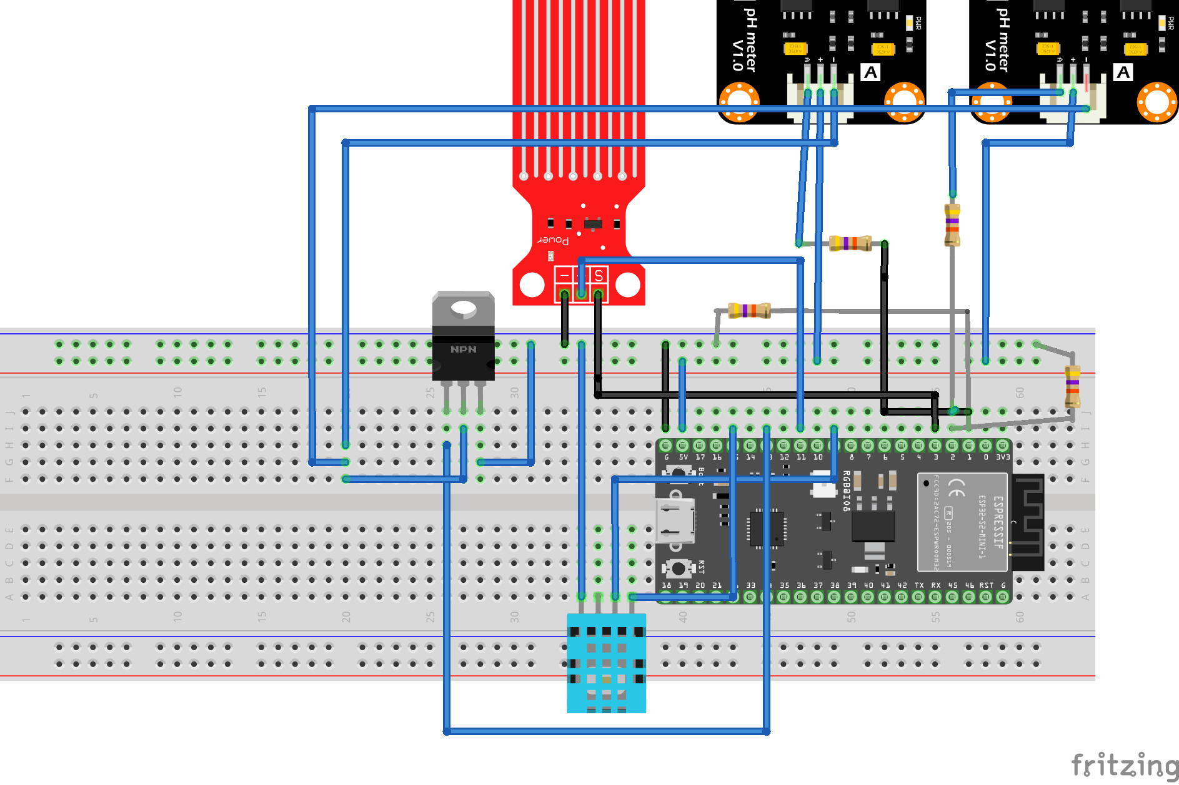
Assembly
3
3

Slide 18
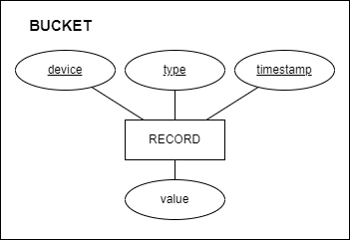
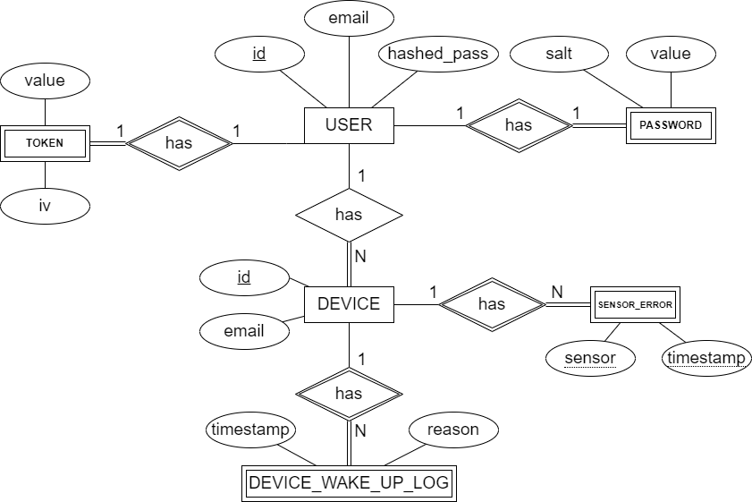
Database
3
3

Slide 19
MQTT Borker - Topics
3
sensor_record: Data collected from sensor {“device_id": “device1", "value": 8.0, "timestamp": 1656330216, "sensor_type": “temperature”}
device_wake_up_log: MCU wake up reason {"device_id": “device1”, "timestamp": 1686330216, "reason": “power on"}
error_reading: Failed attempt to read from sensor {"device_id": “device1", "timestamp": 1686330266, "sensor_type": “initial-ph”}
3 Topics
3

Slide 20
Sensor Analysis
3
A configuration file is used to define each sensor upper and lower bound threshold;
They are processed as soon as they arrive to the Backend;
An email alert is sent when is detected any value that is not safe or when there is a water leak.
3

Slide 21
Backend API
3
Non Authenticated
- Create an account - Login
Admin
- List all users - List all user devices - Visualize sensor data from a user - Visualize device logs from a user
Client
- Create device - Access own devices - Visualize sensor data - Visualize device logs
3

Slide 22
Security
3

Slide 23
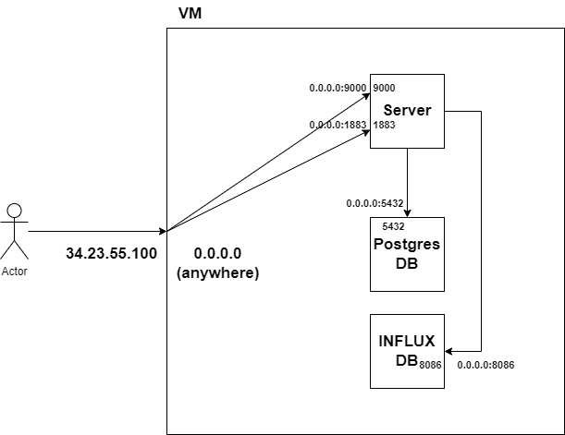
Deploy
3
3

Slide 24
Future Work
3
3

Slide 25
END
Questions ?
29

